Slide 1
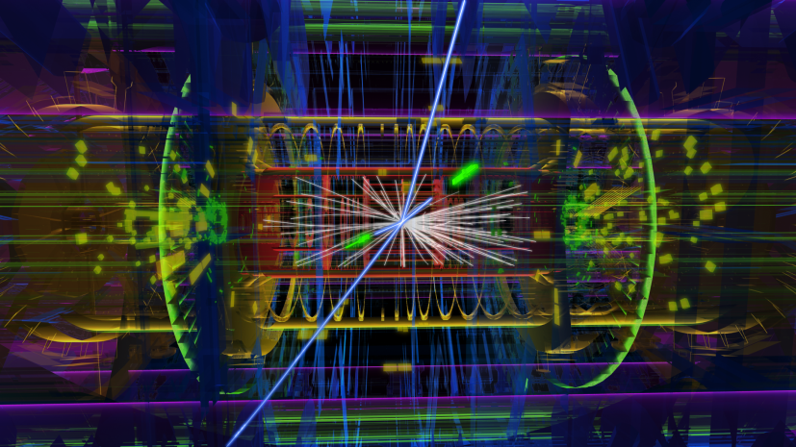



Search for supersymmetry in Multilepton and tau final states with the atlas detector at the LHC
Zinonas Zinonos
Habilitationsvortrag
TUM – 12 December, 2019
Notes:
It’s a pleasure for me to stand here with you and talk about physics at the Terascale.
Given the time constraints
I will attempt to give a helicopter view of selected hot-off-the-press physics results conducted with the ATLAS experiment at CERN
And
Which pretty much reflect my research activity over the last years in Munich.

Slide 2
In this talk…
Searching for Supersymmetry at LHC
Prospects for supersymmetric searches at future experiments
Motivation for Supersymmetry

Slide 3
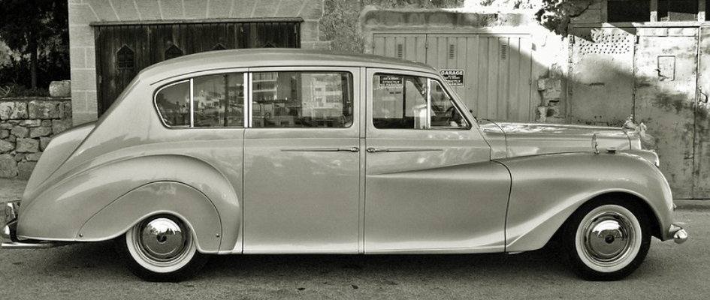
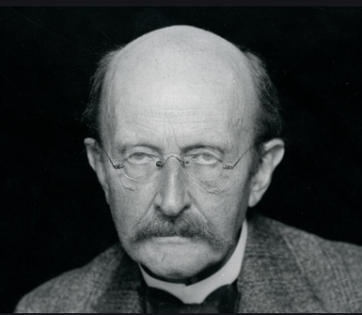


Max Planck
Nobel Price 1918-1919
“in recognition of the services he rendered to the advancement of Physics by his discovery of energy quanta.”
Notes:
Apocryphal story about how Max Planck, after he won the Nobel Prize, went around Germany giving the same standard lecture on the QM.

Slide 4
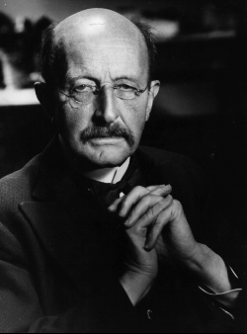
“Cognition precedes application”
Max Planck, 1858-1947
Notes:
Were the famous words of the originator of QM, Max Planck, whose eponym is bearing the physics institute I belong to.

Slide 5
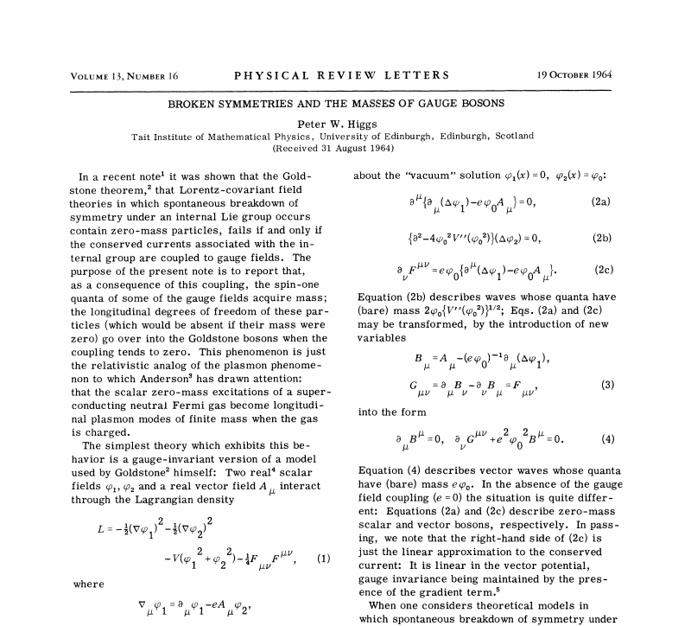
The Triumph of the Standard Model
Knowing the name of something…
Vs.
Knowing something…
R. Feynman
Notes:
This has been valid at a very large extent since the theorization of a framework that incorporates the mass generation mechanism of fundamental particles advanced by ~50 years its experimental discovery and verification.
For many decades, the Phys. Com. was sitting in the position of M.P.’s chauffeur
Since we had the name of the knowledge but lacking its core essence/proof.

Slide 6
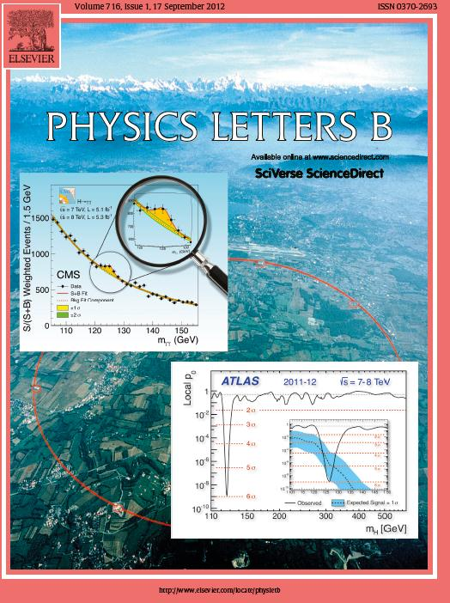
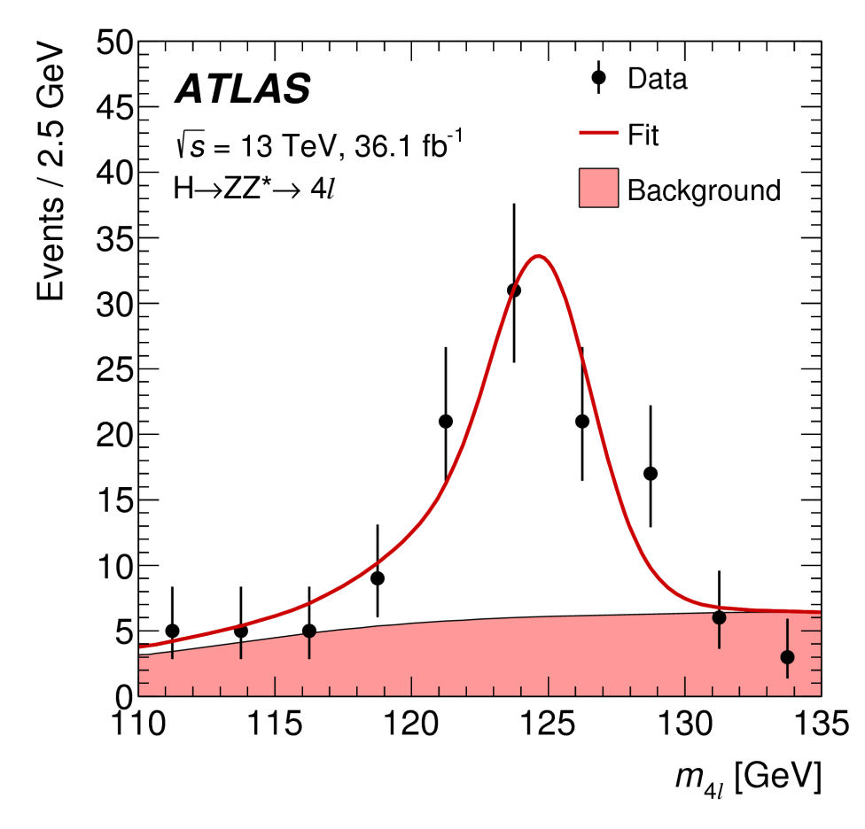
2018
2012
Notes:
Today, a new massive scalar particle is in hands with its experimentally measured properties being consistent with the SM Higgs boson.

Slide 7
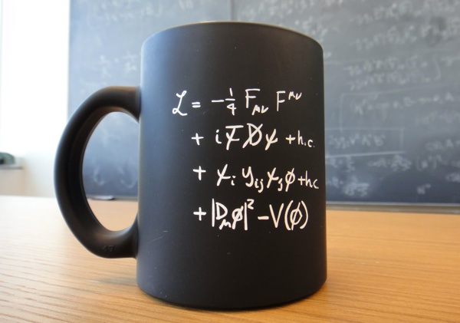
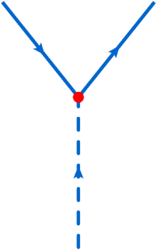
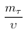
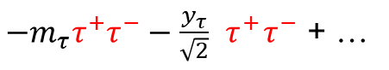
$−m_{τ}τ^{+}τ^{−}−\frac{y_{τ}}{\sqrt{2}}{ τ}^{+}τ^{−}$ + …
τ⁺
τ⁻
H
Higgs 🔗
Notes:
Recent achievements include the verification of the affinity of the Higgs boson to fermionic masses via a Yukawa coupling.
Of the most experimentaly challenging decay channels are the decay to taus and b-quarks.

Slide 8
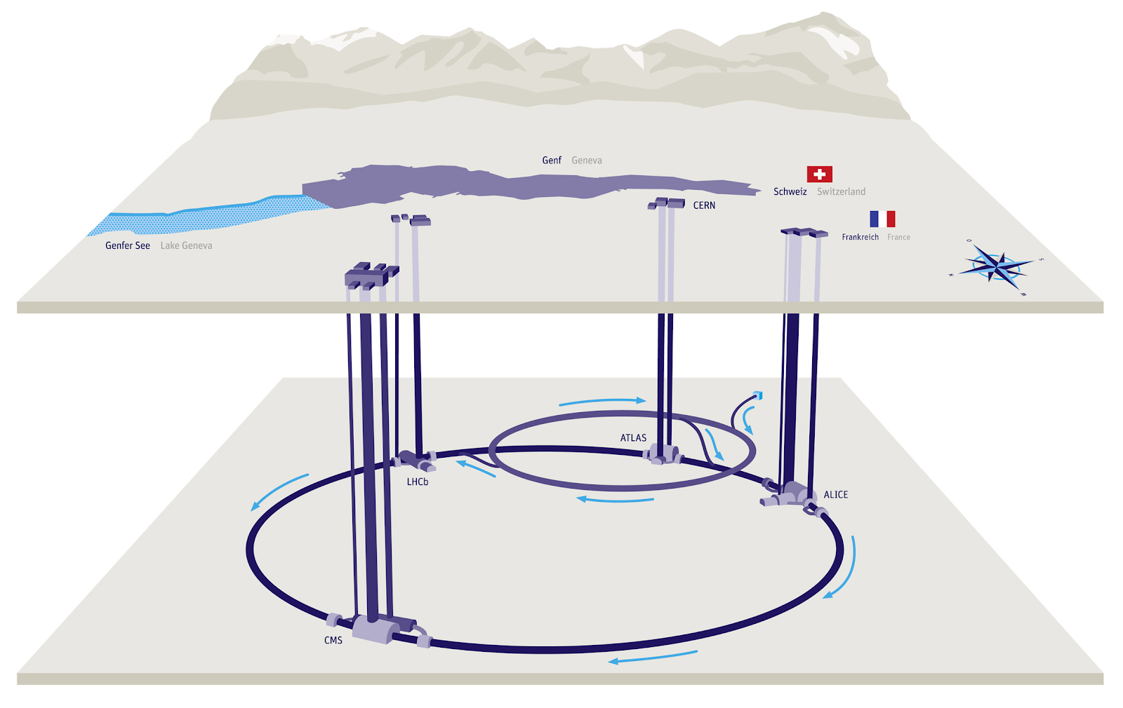
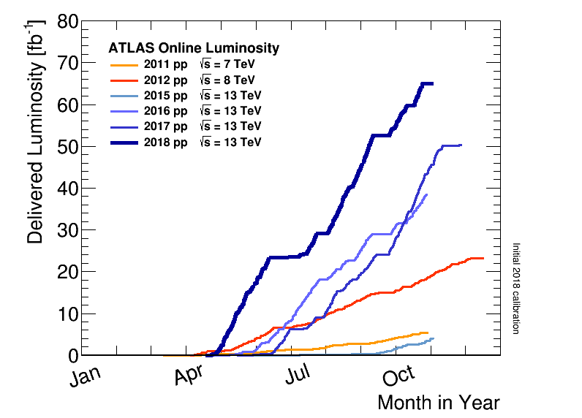
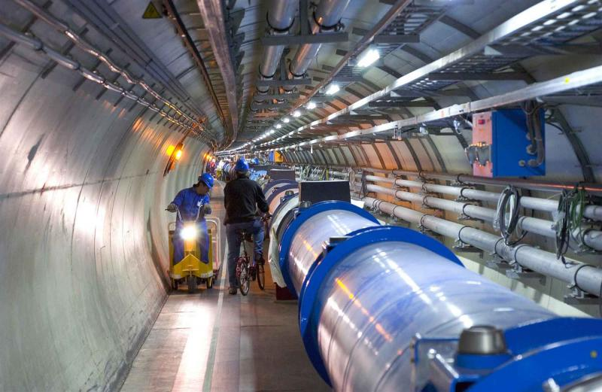
“Application rectifies cognition”
Mankind’s most powerful tool to probe physics at the TeV scale, 2008-2040
Notes:
The discovery of the Higgs boson, at a collider machine with extraordinary performance, was the triumph and successful validation of the predictive power of the unified EWK theory.

Slide 9
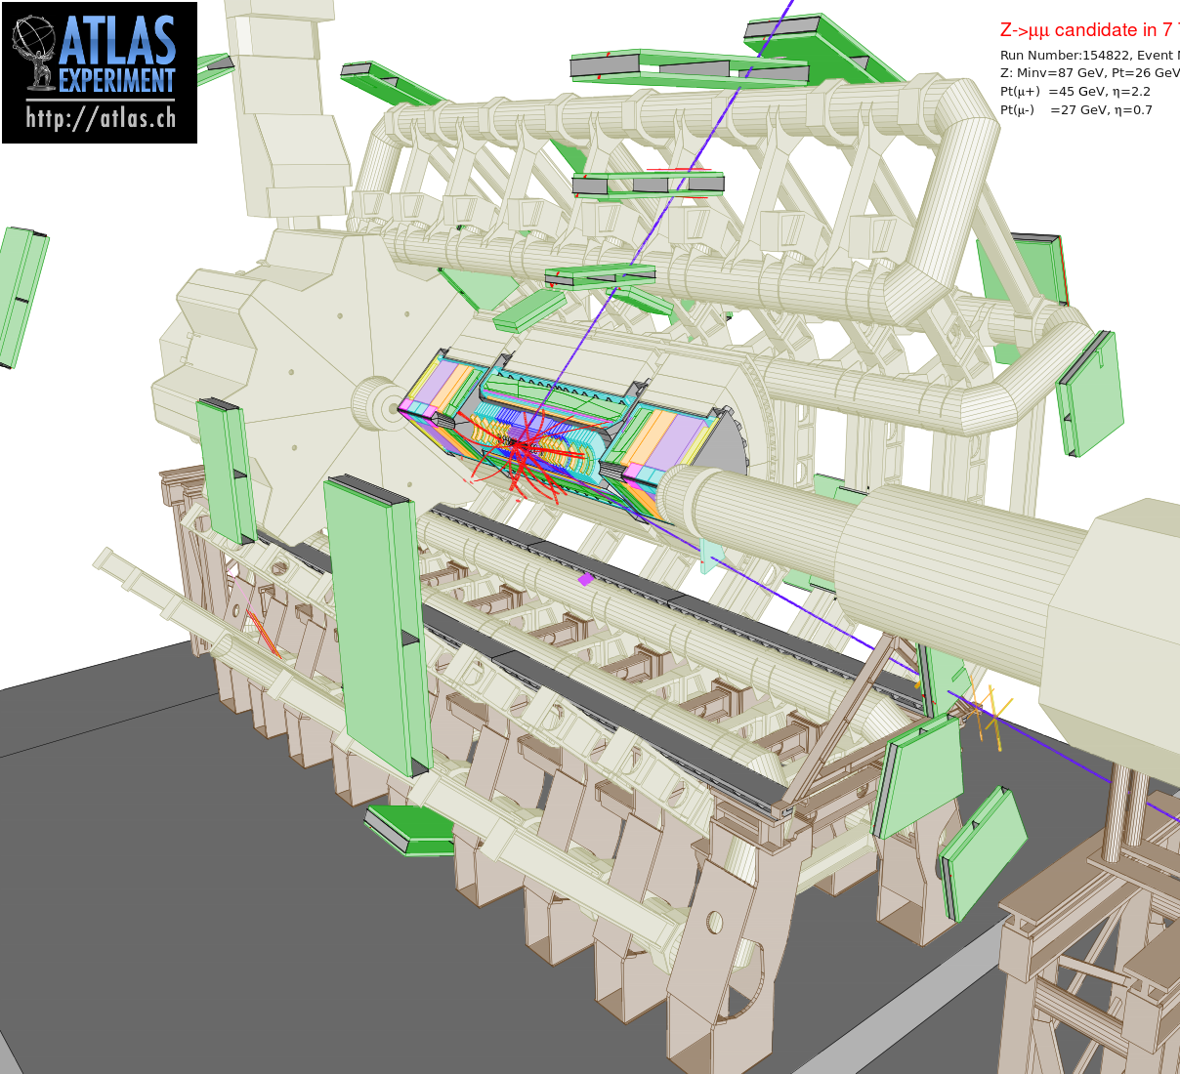
The ATLAS
Detector
Multi-purpose detector
Giant, symmetric, 4π hermetic
Highly data-taking efficiency
Excellent particle identification
e, μ, τ
b, c flavor jets
quark/gluon jets
π, K, ρ, J/ψ,…
Precise reconstruction
missing energy
Top quark
W, Z, H
Notes:
For achieving this goal, superb detection apparatuses are a fundamental need.
This is the giant ATLAS detector situated at the LHC tunnel, with extraordinary detection and identification capabilities for almost all SM particles.
Modern detectors at colliders, such ATLAS, have extraordinary abilities to reconstruct and give identity (with high precision) to even complicated objects, such as taus.
A task which was largely at limit of impossible in past experiments.

Slide 10
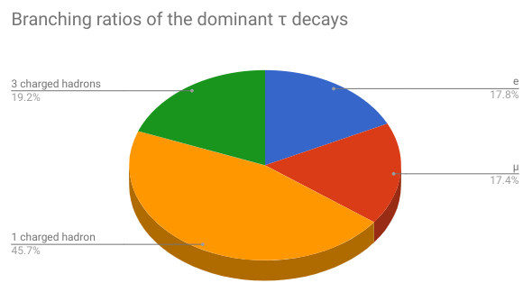
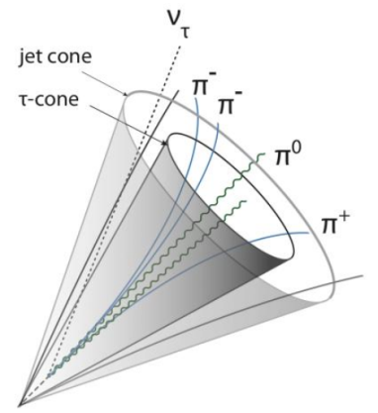
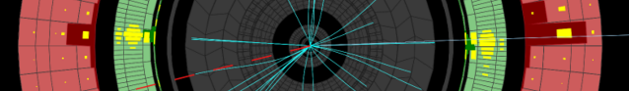
Tau Identification
✓
unexplored
✓
3-track τ_{h}
1-track τ_{h}
Notes:
Due to its mass, the tau lepton can decay either hadronically or leptonically in a narrow cone.
Experimentally, it turns out only possible to identify the hadronic decay modes associated to 1 or 3 charged tracks in a cone with collimated energy clusters.

Slide 11
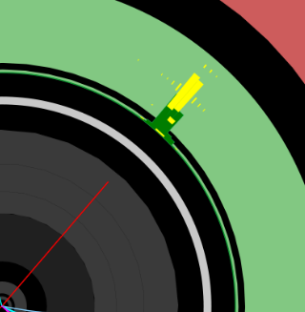
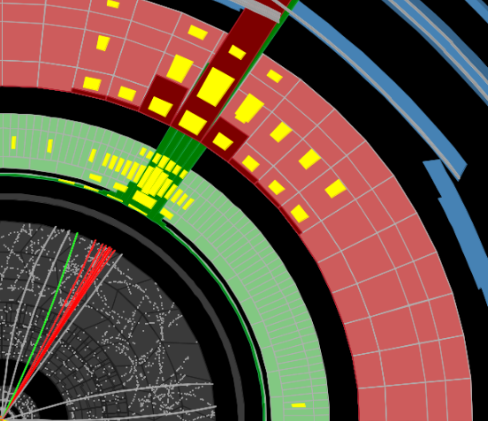
electron
QCD jet
Notes:
Despite its peculiar decay signature, taus can be mimicked by electron or hadronic showers that have similar characteristics
As shown in this snapshot
Making its identification among e’s and jets very challenging.

Slide 12
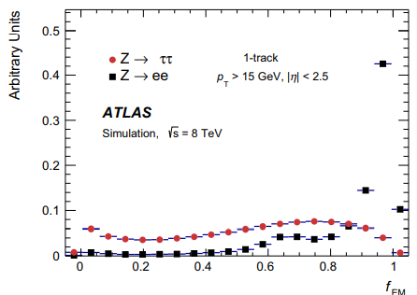
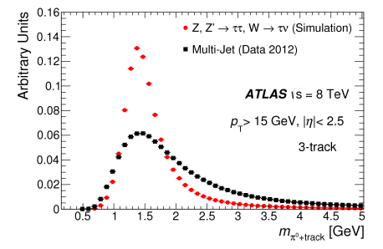
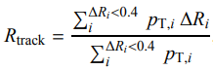
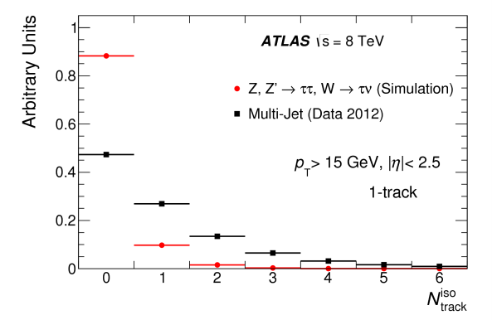
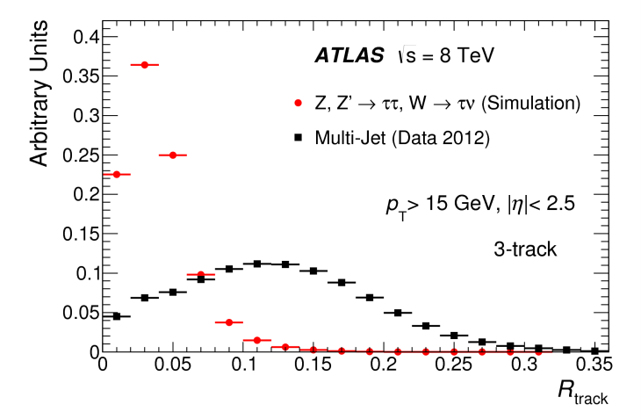
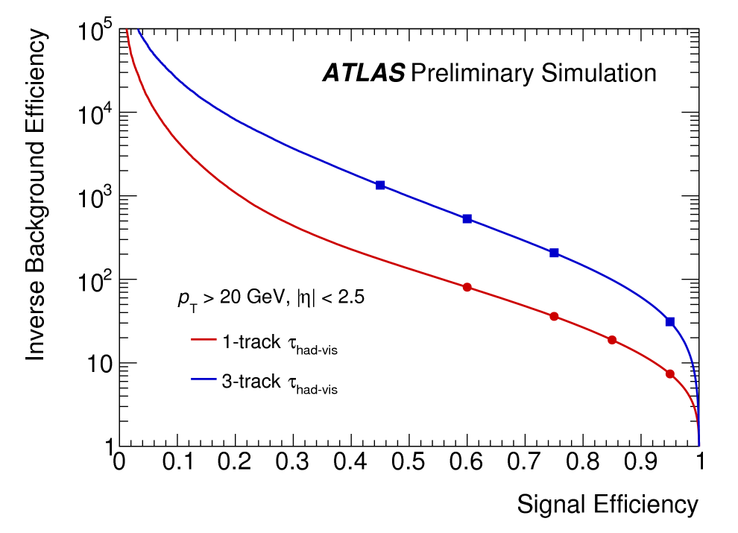
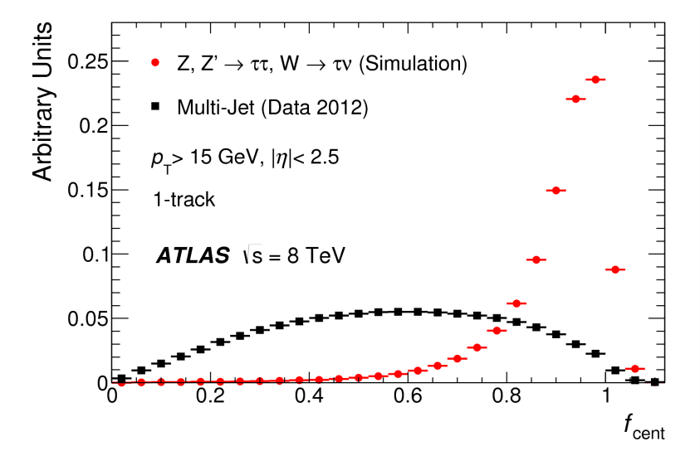
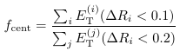
Machine
Learning
12
Taus 🔗
Notes:
AI can greatly help to overcome this problem.
The combination of tracking and calorimetric quantities that discriminate real hadronic taus from fakes in a ML classification algo
Can provide a robust selection of the signal taus and rejection of the background.

Slide 13
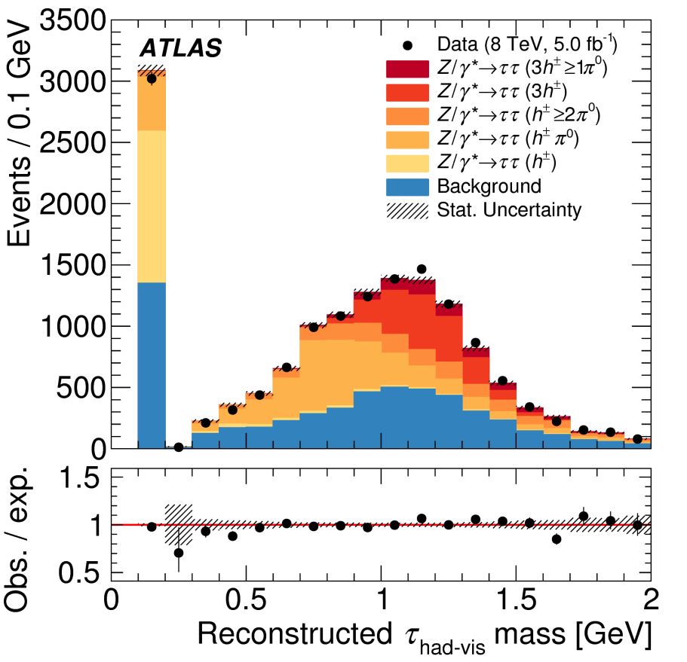
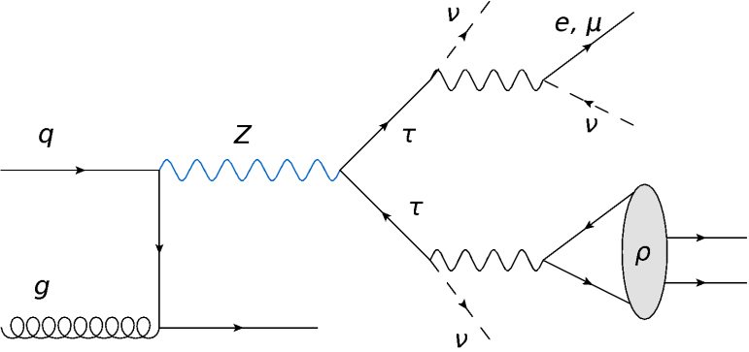
τ⁻ → ν_{τ} π ⁻ π⁰
ρ(770)
Notes:
Nowadays ATLAS acquainted more advanced skills by probing the substructure of the tau decay
And identifying its intermediate resonances, such as the ρ meson; a great tool for tau polarization studies.

Slide 14
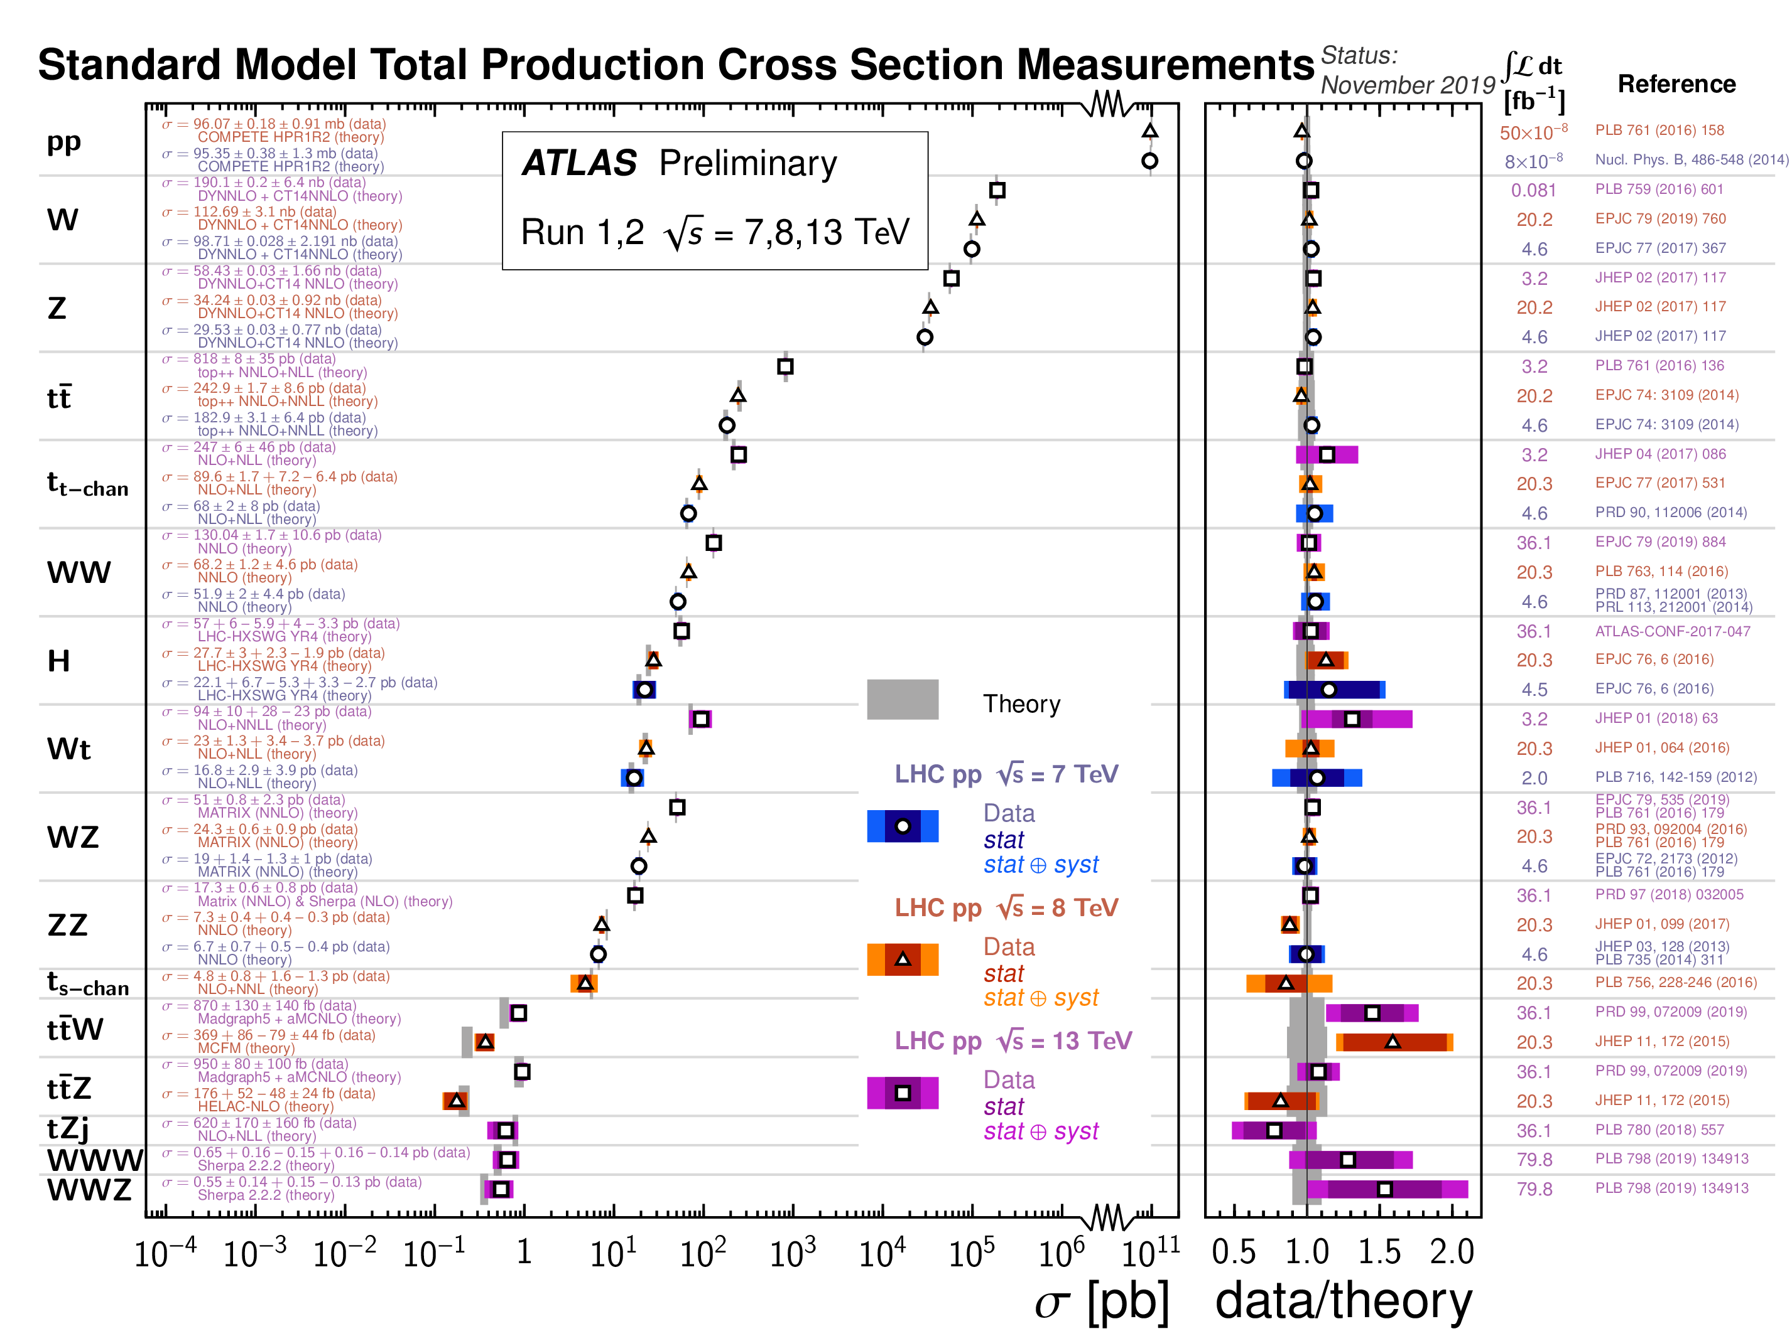
The SM
A tremendously
predictive model!
But…
Notes:
Since the switch-on of LHC in 2009, experimentalists proved that the tremendous SM prediction power is in agreement with what data say.
Spanning from very commonly occurring processes (Gauge boson production) down to the very rare SM phenomena (triboson production).
But despite the great success, this theory comes with several shortcomings…

Slide 15
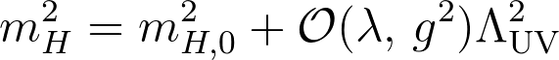
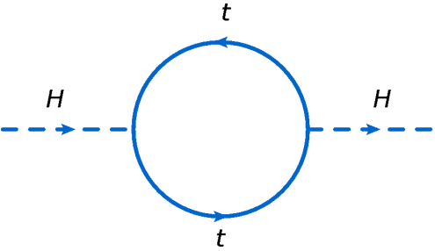
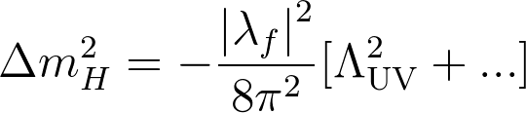
The Gauge Hierarchy Problem
=
+ …
Divergent at the Planck energy scales…
→ Large energy cut-off requires a fine-tuning of low-energy theory parameters.
Notes:
The discovery of a Higgs boson at 125 GeV has raised new urgency to the question of how the SM as a low-effective theory can describe phenomena at very high energy scales where the unification of forces is believed to occur.
In particular, the Higgs M is not protected against quadratic quantum corrections that inevitably arise in the SM at a cut-off E scale up to which it is still valid.
Addressing this question is one of the major goals of the LHC program for the next decade and beyond.

Slide 16
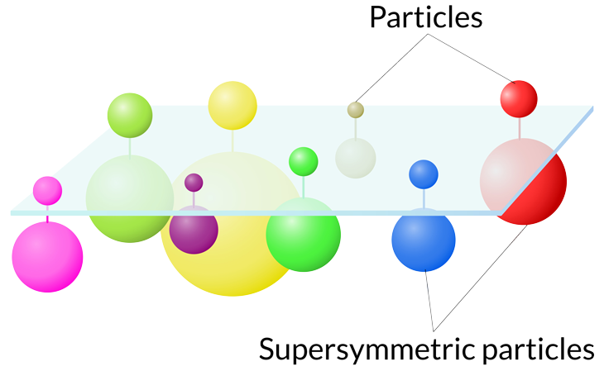
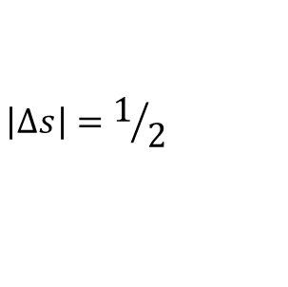
Supersymmetry
$$\left|Δs\right|=1/2$$
Notes:
SUSY comes to provide an elegant approach to provide solutions to such challenges.
It is maybe the best motivated theory and compelling possible extension of SM.
It is a space-time symmetry that postulates the existence of new particles with ½-unit spin difference from their SM partners.
For example, each SM fermion or boson is associated with a superpartner, having the same quantum numbers as its partner except for spin.

Slide 17
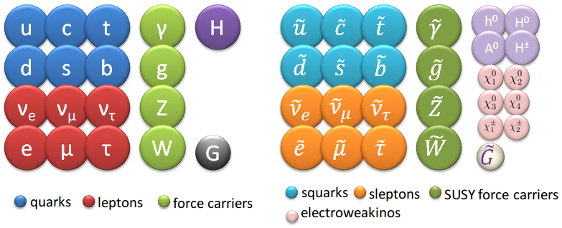
Notes:
The scalar superpartners of the SM fermions are called sfermions (comprising the charged sleptons, the sneutrinos & squarks)
The gluons are associated to fermionic superpartners called gluinos (g̃). The weak gauginos wino, bino are fermionic superpartners of the SU(2)×U(1) gauge fields of the SM. The higgsino fields are superpartners of the 2 complex scalar doublets of a minimally extended Higgs sector. Their mass eigenstates are referred to as charginos and neutralinos numbered in order of increasing mass.

Slide 18
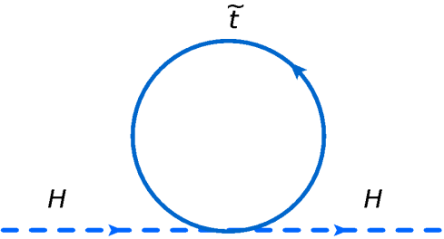
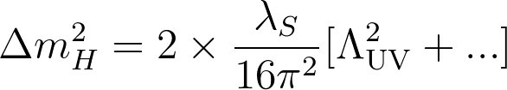
Naturalness
=
+ …
→ Natural cancellation of divergent quantum loop terms.
Notes:
The introduction of these new SUSY particles provides therefore a natural solution to the hierarchy problem via cancellation of the quadratic loop corrections of the SUSY counterparts,
Rather addressing it via an unwanted fine tuning.

Slide 19
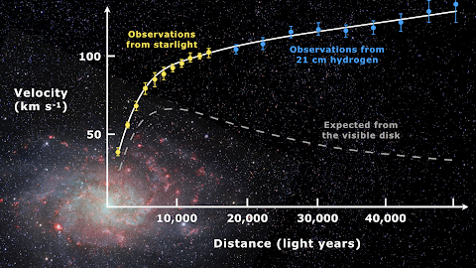
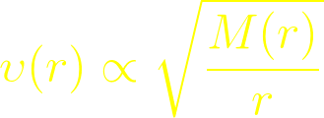
Rotational
stable Keplerian orbit
Notes:
Another of the main shortcomings of the SM theory is that it does not provide an explanation about the DM as measured by astronomical observations, which accounts for ~26% of the universe energy density.
In SUSY, if the LSP is stable, it qualifies a promising candidate as DM particle (WIMP).
-----
Observation evidences:
Galaxy rotation curves. kepler’s 2nd Law: rotational velocities decrease with distance from center
Gravitation lensing. Measure distortion geometry to infer the mass of intervening cluster → the mass-to-light ratios obtained match to the predicted DM densities.
Bullet cluster. Collision of 2 galaxy clusters: s apparent center of mass is far displaced from the baryonic center of mass.

Slide 20
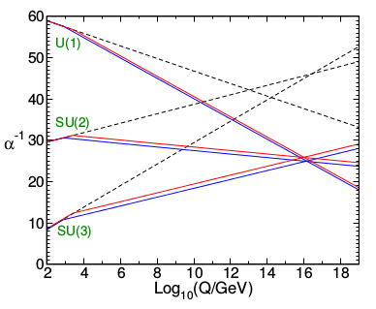
Unification
SM
→MSSM: Successful gauge coupling unification at GUT scales.
MSSM
GUT
Notes:
Additionally, SUSY provides a framework for the unification of forces at the Planck energy scale.
Predicts that gauge couplings as measured experimentally ay the EWK scale unify near the Planck scale.

Slide 21
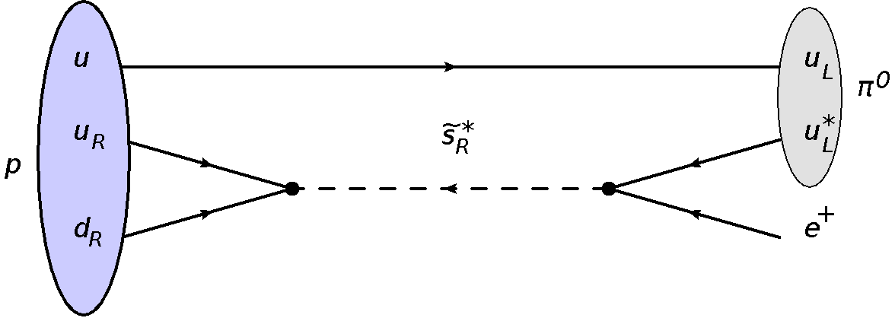
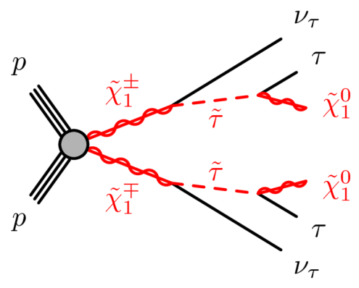
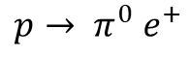

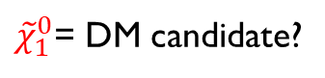
R-Parity
+1 (SM)
-1 (MSSM)
R = (-1)^{3(B-L)+2s}
$$p→ π^{0} e^{+}$$
${\tilde{χ}}_{1}^{0}$= DM candidate?
Notes:
In the absence of a protective symmetry, SUSY processes not conserving L and B could result in a rapid PROTON, in conflict with the tight experimental constraints on its lifetime.
This conflict can be avoided by imposing the conservation of R-parity which implies
sparticles must be pair-produced
LSP is produced at the end of the decay chain
should be absolutely stable and weakly interacting
qualifying thus itself as the most promising candidate for DM particle.
A canonical signature of conventional RPC scenarios is MET due to the escaping LSP (behaves like a heavy neutrino).
(SUSY phenomenology in scattering processes crucially depends on whether R-parity is conserved.)

Slide 22
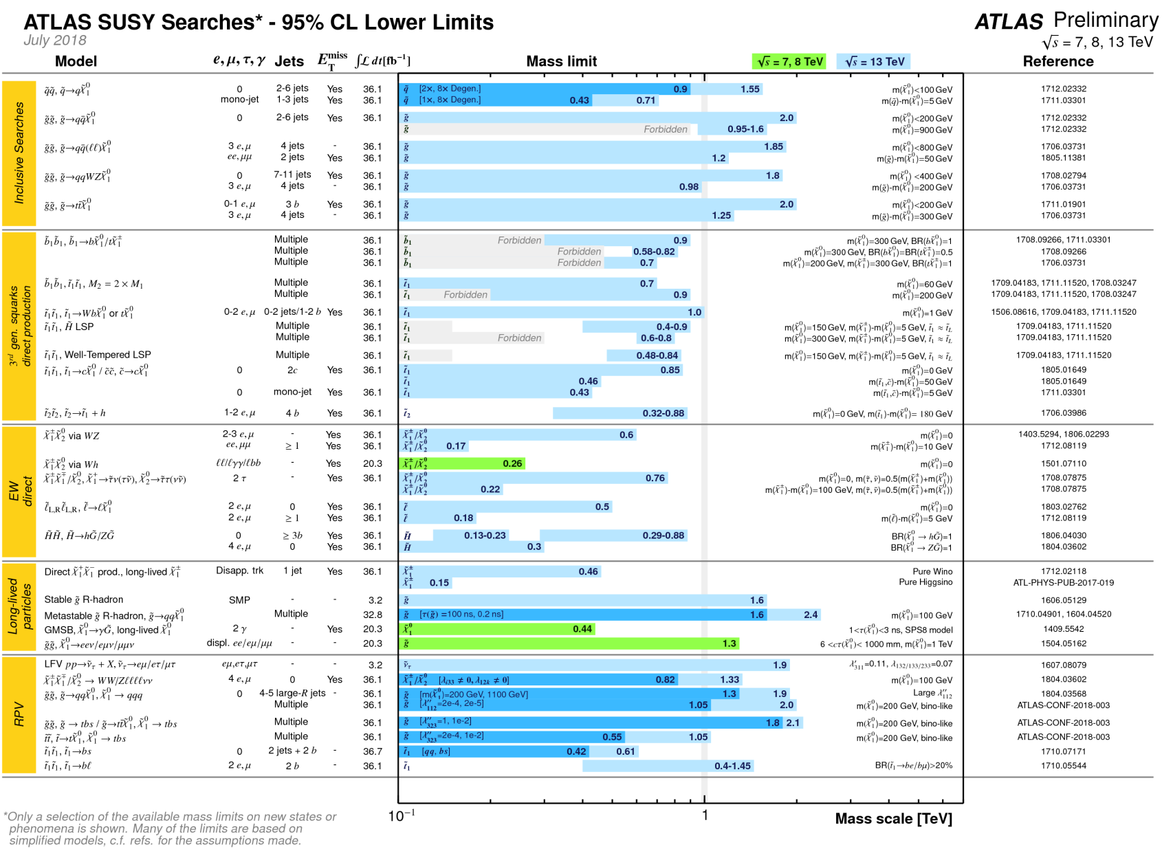
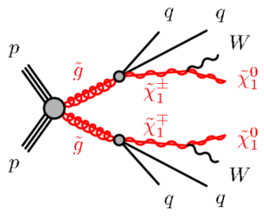
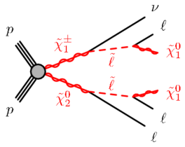
Landscape
colored
sector
electroweak
sector
Notes:
The full program of ATLAS covers a wide range of SUSY searches, which exclude scenarios up to the TeV and EWK mass scale for the strong and EWK sector, respectively.

Slide 23
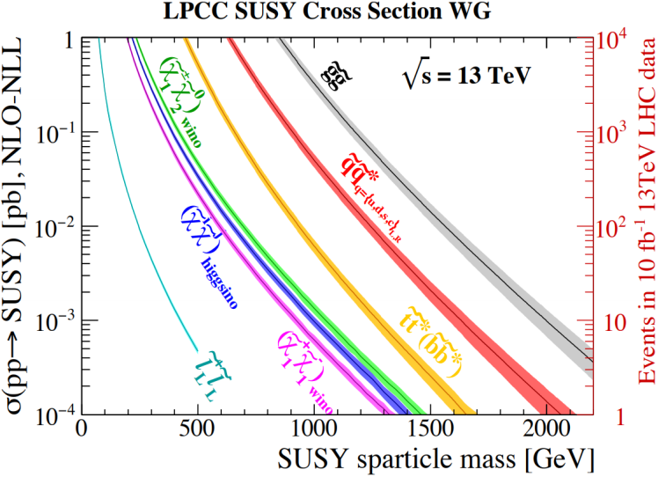
SUSY Searches: The name of the game
Strong
SUSY
strong
SUSY
Ewk
SUSY
Notes:
This is mainly due to the apparent production cross sections for the strong processes being in a hadronic collider, typically lying (at least) an order of magnitude higher than the EWK ones.

Slide 24



Multilepton Searches
Wino
Slepton
Gluino
LLE_{12k} → e, µ
R-Parity Violating scenarios with λ_{ijk} Yukawa couplings
L = Lepton SU(2)-doublet super-field
E = Lepton singlet super-field
LLE_{i33} → τ
Notes:
Multilepton SUSY final states are of great interest in the quest of SUSY.
Despite their relatively small production XS, their phenomenology comprising of at least 4 charged leptons helps to effectively suppress the SM Bkgs.
Such 4L events may arise from RPV models, in which the LSP is allowed to decay via a Yukawa coupling.
Searches can be therefore performed by looking at 2 extremes cases: …

Slide 25






Z*
μ
W*
Higgsino triplet
Soft-p_{T} leptons
Z/h
Hard-p_{T} leptons
General Gauge-Mediated Supersymmetry breaking
Off-shell
gauge bosons
On-shell
Z/h
Notes:
The exclusion of gluino and stop masses up to the TeV motivates now the light higgsinos to be the first sparticle to be discovered at LHC, as motivated by naturalness.
In General Gauge Mediated (GGM) SUSY models, the G̃ is nearly massless and is the LSP offering the possibility to study light Higgsinos.
The members of the higgsino triplet are almost mass degenerate and their cascade decays result in low-momentum decay products that are difficult to reconstruct efficiently.
On the other hand, the decays of the higgsinos to the LSP G̃ would lead to on-shell Z/h, and the decay products can be reconstructed.
Typical signal events are characterized by multiple charged leptons substantial MET.

Slide 26

Event Categorization Strategy
taus
m_{eff}
2l + 2τ
3l + 1τ
high
GGM $\tilde{h}$
RPV
low
4l + 0τ
low
high
E_{T}^{miss}
Notes:
What is then a smart way to select such SUSY events?
The obvious strategy splits the event phase-space into: …
GGM Hino event selection targets events with…
RPV 4L selection is optimized with low / high Meff requirments and ...

Slide 27



RPV Limits
RPV $\tilde{g}$
NLSP
RPV Wino NLSP
Notes:
After applying event selection criteria, MET & Meff are found to be strong discriminators to select 4L events.
In the absence of significant excess of data over predicted background, the results can be interpreted in simplified RPV models.
Left: Gluino. Right: Wino

Slide 28




GGM Limits
h
Z
MultiLep 🔗
Notes:
The same observations hold for the GGM-hino signal regions.
These are the exclusion contours for the higgsino GGM model in final states with at least 4b-jets or 4 light leptons.
Have sensitivity to different scenarios with a branching ratio favoring either Z or h.
The admixture is not yet excluded leaving this as prospect for future experiments, such as HL-LHC.

Slide 29


Searches with taus
DM Relic Density $Ω_{DM}h^{2}≃0.1$
DM Relic Density Ω_𝐷𝑀 ℎ^2≃0.1
Enchanced $h→γγ$ rate
Enchanced ℎ→𝛾𝛾 rate
µ magnetic anomalous moment
$\tilde{τ} − {\tilde{χ}}_{1}^{0}$ coannihilation
Notes:
Another class of searches are those involving the production and decay of staus.
If the 3rd slepton generation is light enough, the coannihilation with the LSP will lead to a relic DM density value consistent with the astronomical measurements.
Also, light staus are attractive since they can affect the Higgs decay rate into γγ, AND light sleptons explaining thus the g-2 discrepancy in SM.

Slide 30




Analysis Strategy
$$E_{T}^{miss}$$
$$m_{{\tilde{χ}}_{1}^{0}}$$
high
kinematically allowed region
low
low-mass region
high-mass region
$$m_{{\tilde{τ}}_{}^{}}$$
Suppress SM background with stransverse mass:
$$m_{T2}=\min_{q_{T}}\left\{\max_{}\left\{m_{T}^{τ_{1}}\left(p_{T}^{τ_{1}},q_{T}\right),m_{T}^{τ_{2}}\left(p_{T}^{τ_{2}},{p_{T}^{miss}−q}_{T}\right)\right\}\right\}$$
Notes:
The analysis search exploits the MET and stransverse mass observable to optimize the sensitivity to staus,
into regions with low/high MET
targeting scenarios with low/high stau mass
Mt2 is…

Slide 31




LEP LHC/CMS LHC/ATLAS
$τ→hadrons, leptons$ $τ→hadrons$
$m_{\tilde{τ}}≲90 GeV$ $m_{\tilde{τ}}≲150 GeV$ $m_{\tilde{τ}}≲390 GeV$
~20 years
Staus ATLAS 🔗
Staus CMS 🔗
Notes:
By this year, the most stringent limits were set by LEP at 90 GeV
With the LHC experiments having difficulties with being sensitive at higher m.
However, this year both experiments released results showing the exclusion of stau masses assuming a nearly massless LSP…
Big motivation to search for such scenarios at the HL-LHC with a discovery possibility up to TeV of stau masses.

Slide 32






A glimpse to the future
⟨μ⟩ ≈ 30
LHC
HL-LHC
⟨μ⟩ ≈ 200
Notes:
An ambitious program is foreseen to be launched in about 6 years from now bringing significant improvements in the data statistics.
However, operating at 7x the nominal Lumi of LHC, it will dramatically multiply the experimental challenges by
increasing significantly the Int’s/B.C. creating harsher environments
increasing the risk of radiation damage for the detectors
size of data event
The detectors must therefore undergo significant upgrades to mitigate these new challenges.

Slide 33



Probe New Physics Through Rare Processes
κ_{t}
κ_{λ}
+
TGC
-
-
QGC
~9k HH→bbττ events
@ 3ab⁻¹,√s = 14 TeV
Notes:
At the same time, the physics potential is considerably higher providing the possibility to measure rare SM phenomena with implicit hints on New Phys
For example,
the trilinear H couplings (test the stability of vacuum)
differential σ of H
Quartic Gauge Couplings which are sensitive to new physics

Slide 34


Expand Potential at HL-LHC
Stau combined exclusion
Notes:
HL-LHC is a big motivation to search for stau scenarios with a exclusion possibility up to 700 GeV of stau mass.
And discovery up to a Half TeV → possibly provide answers for DM mystery.

Slide 35


Few wrap-up thoughts
Absence of observation of new phenomena…
significant constraints on SUSY parameter space
Squeezing further SUSY’s landscape…
LHC $\sqrt{s}=7 →8 →13$TeV → rapid shifts in SUSY limits
LHC at the edges of its skills → future sensitivity to mostly originate from high-stats & sophisticated techniques
Era of HL-LHC and other future colliders…
Increase sensitivity for colored sparticles
But expanded dataset beneficial for electroweak gaugino searches as well
Probe strenuous final states: compressed particle spectra, long-lived particles, RPV scenarios…
Notes:
Before closing up, let me share with you ….

Slide 36


Synopsis
Culmination of work and plethora of exciting physics searches at LHC:
SUSY multilepton searches, SUSY stau searches, tau lepton reconstruction & identification …
Placed stringent limits on SUSY scenarios up to the TeV mass scale.
With the HL-LHC and other future collider projects, the exploration of physics at the Terascale is more plausible than ever!
Copious data at unprecedented center-of-mass energies are expected to unveil hidden sectors of the Fabric of the Cosmos.
The future of High Energy Physics is bright!

Slide 37

Special thanks to:
Thank You!

Slide 38
References
[Higgs] Cross-section measurements of the Higgs boson decaying into a pair of tau leptons in proton-proton collisions at √s = 13 TeV with the ATLAS detector, ATLAS Collaboration,.In: Phys. Rev. D99 (2019), p. 072001. doi: 10.1103/PhysRevD.99.072001. arXiv: 1811.08856 [hep-ex].
[Taus] Measurement of the tau lepton reconstruction and identification performance in the ATLAS experiment using pp collisions at √s=13 TeV, ATLAS Collaboration. 2017, ATLAS-CONF-2017-029
[MultiLep] Search for supersymmetry in events with four or more leptons in √s = 13 TeV pp collisions with ATLAS. ATLAS Collaboration. In: Phys. Rev. D98.3 (2018), p. 032009. doi: 10.1103/PhysRevD.98.032009. arXiv: 1804.03602 [hep-ex].
[Staus ATLAS] Search for direct stau production in events with two hadronic tau leptons in √s = 13 TeV pp collisions with the ATLAS detector". ATLAS Collaboration, In: ATLAS-CONF-2019- 018, Submitted to PRD with reference number DL12561.
[Staus CMS] Search for direct tau slepton pair production in proton-proton collisions at √s = 13 TeV. Tech. rep. CMS-PAS-SUS-18-006. Geneva: CERN, 2019. url: http://cds.cern.ch/record/2669190.

Slide 39

The ATLAS Detector
Muon Spectrometer
Precision Tracking
Trigger Chambers
Calorimeters
LAr EM
LAr Hadronic
End-Cap &
Forward
Tile sampling
HAD calorimeter
Inner Tracker
Silicon pixel detector
Semiconductor tracker
Transition radiation tracker
Superconducting
Magnets
multi-purpose - 4π hermetic
forward-backward
symmetric cylindrical symmetry
Solenoid 2T axial
Toroid Air-core 8-coil 4T

Slide 40





Signal Phenomenology in a Nutshell
sparticle masses
mass degenerate
triplet
strong production
bino LSP
wino NLSP
higgsino NLSP
bino/higgsino mix
$$\left|M_{1} \right|≪{|M}_{2},μ|$$
$\left|μ\right|≪{|M_{1},M}_{2}|$
$$\left|M_{1},M_{2}\right|≪|μ|$$
$$\left|μ,M_{1}\right|≪{|M}_{2}|$$
In the EW sector, the mass eigenstates and mixing angles depend principally on the parameters:
SUSY-concerving higgsino-mixing mass μ
gaugino Majorana masses M₁ (bino), M₂ (wino)
EW production
Composition-dependent cross-sections

Slide 41



RPV Scenarios
Simplified models of with RPC cascade & RPV decay scenarios where the LSP is a bino-like & prompt 10 ≤ m_{LSP} ≤ m_{NLSP} -10 GeV
The RPV LSP decay is mediated by the lepton-number-violating super-potential term:
m-degenerate wino-like NLSP
Yukawa coupling
Lepton singlet
super-field
m-degenerate
Lepton SU(2)-doublet super-field
Two extreme scenarios of the Eare considered with different sensitivity
LLE12k: e,μ - enriched
LLEi33: τ-favored
gluino pair-produced NLSP

Slide 42




RPC Scenarios
RPC scenarios with light higgsino states are well motivated by naturalness
General Gauge Mediated (GGM) SUSY models predict $\tilde{G}$ is nearly massless → opportunity to study light higgsinos
Experimentally challenging, as members of the higgsino triplet are close in mass → low-momentum decay products
Decays of the higgsinos to the LSP $\tilde{G}$ lead to on-shell Z/h → decay products that can be eventually reconstructed
is set as a free parameter in final states with 4l + Z candidate
off-shell
gauge bosons
on-shell
Z/h

Slide 43
Signal Phenomenology in a Nutshell
sparticle masses
mass degenerate
triplet
strong production
bino LSP
wino NLSP
higgsino NLSP
bino/higgsino mix
$$\left|M_{1} \right|≪{|M}_{2},μ|$$
$\left|μ\right|≪{|M_{1},M}_{2}|$
$$\left|M_{1},M_{2}\right|≪|μ|$$
$$\left|μ,M_{1}\right|≪{|M}_{2}|$$
In the EW sector, the mass eigenstates and mixing angles depend principally on the parameters:
SUSY-concerving higgsino-mixing mass μ
gaugino Majorana masses M₁ (bino), M₂ (wino)
EW production
Composition-dependent cross-sections

Slide 44

Search Regions & Backgrounds
SR0A
≥ 4 light charged leptons
SR0B
≥ 4 light charged leptons
RPV LLE12k
General search
low meff cut
high meff cut
SR0C
≥ 4 light charged leptons
SR0D
≥ 4 light charged leptons
higgsino GGM
higgsino GGM
low MET cut
high MET cut
SR1
3 light charged leptons, ≥ 1 τ
SR2
2 light charged leptons, ≥ 2 τ
RPV LLEi33
RPV LLEi33
Background | Lepton Definition | Physics Processes | Estimate
Irreducible | prompt & genuinely isolated | $ZZ, t\overline{t}Z,t\overline{t}WW,tWZ, VVZ$, $t\overline{t}t\overline{t}$, $t\overline{t}$tW, Higgs | MC
Reducible | non-prompt or non-isolated or mis-identified (fake) | $t\overline{t}$, $t\overline{t}$W, $t\overline{tt}$, Z+jets, WZ, WW | Data

Slide 45


4-Lepton Results
m_{eff}
SR0A & SR0B
m_{eff}
SR2
Observations are consistent with the SM expectations within a local significance of at most 2.3σ

Slide 46








Results Interpretation
RPV $\tilde{g}$
NLSP
RPV Wino NLSP
$LL\overline{E}$12k
$LL\overline{E}$12k
$$LL\overline{E}i33$$
$$LL\overline{E}i33$$
Exclusion limits extend to very high masses due to high lepton multiplicity
⇒ x2 mass reach in the upper limits w.r.t. the $\sqrt{s}$=7,8 TeV analysis
Signal model excluded at 95% CL (CL_{s} of the s+b hypothesis < 0.05)

Slide 47






Stau searches
→ Mass of lightest 3rd-generation sparticles, ${\tilde{\text{χ}}}^{±}$ and ${\tilde{\text{χ}}}^{0}$should be ~O(100 GeV)
- arguments suggested by Naturalness to protect m_{H} from quadratically divergent quantum corrections
→ Models with light $\tilde{τ}$ are consistent with current matter data from cosmological observations
→ In the context of pMSSM, EW production of direct $\tilde{τ}$’s becomes dominant if ${\tilde{\text{χ}}}^{±}$ and ${\tilde{\text{χ}}}^{0}$are heavy ( is bino-like):
Simplified model with
stau mixing

